Slide 1
Development of an Automated Class Schedule Allocation Method

Slide 2
Group Member
Tanvir Hasan Emon 011181077
Partho Protime Sarkar 011181090
Efat Ahmed Sohel 011181097
Farhana Afroz 011181187
Joyosree Acharjee Tithi 011182104
Tahmina Tanjin Sharna 011182051
Project Supervisor
Prof. Dr. Hasan Sarwar

Slide 3
Outline
Problem Statement : Page 4 - 9
Motivation : Page 10
Literature Review (Taxonomy): 11
Gap Analysis and Reference : 12, 13
Objectives:14
Requirements Analysis : 15, 16
Context Diagram : 17
Data Flow Diagram : 18
Requirement Specification : 19
Implementation : 20 - 42
Standards : 42
Constraints : 43
Budget and Cost Analysis : 44
Task Allocation : 45
Future Work : 46

Slide 4
Problem statement
Generate Preferable Time Schedule
Hassle free Section Selection
Generating Conflict Free class schedule

Slide 5
What is wrong with manual process ??

Slide 6
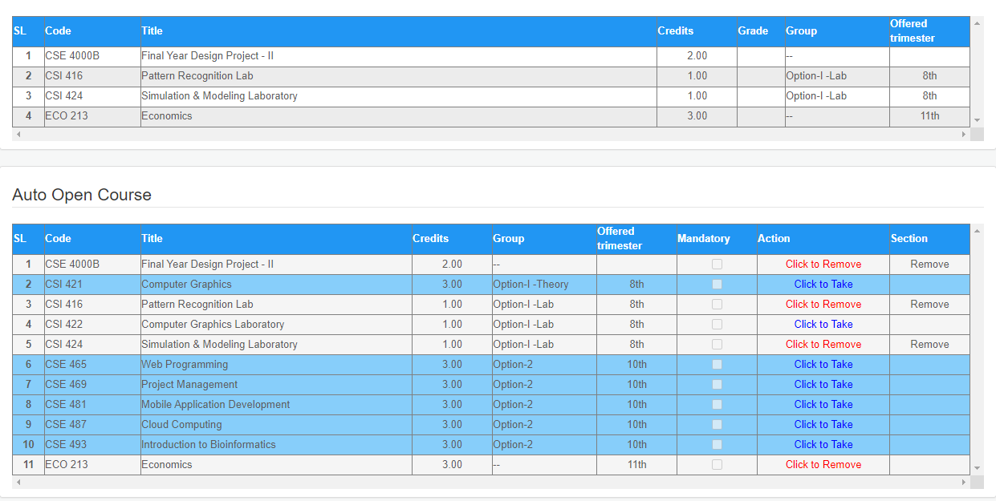
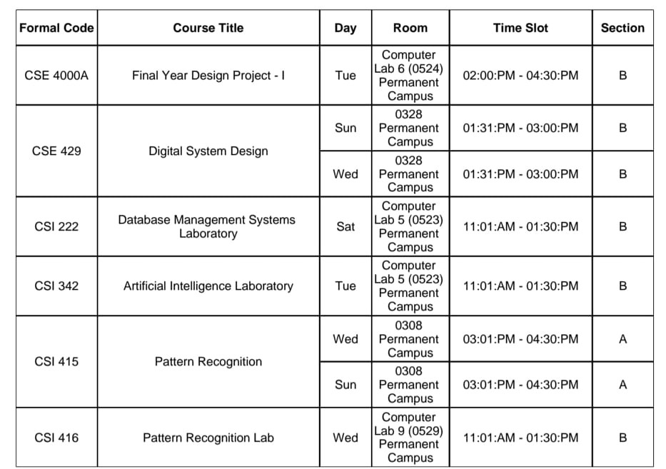
Advising
Pre-Advising

Slide 7
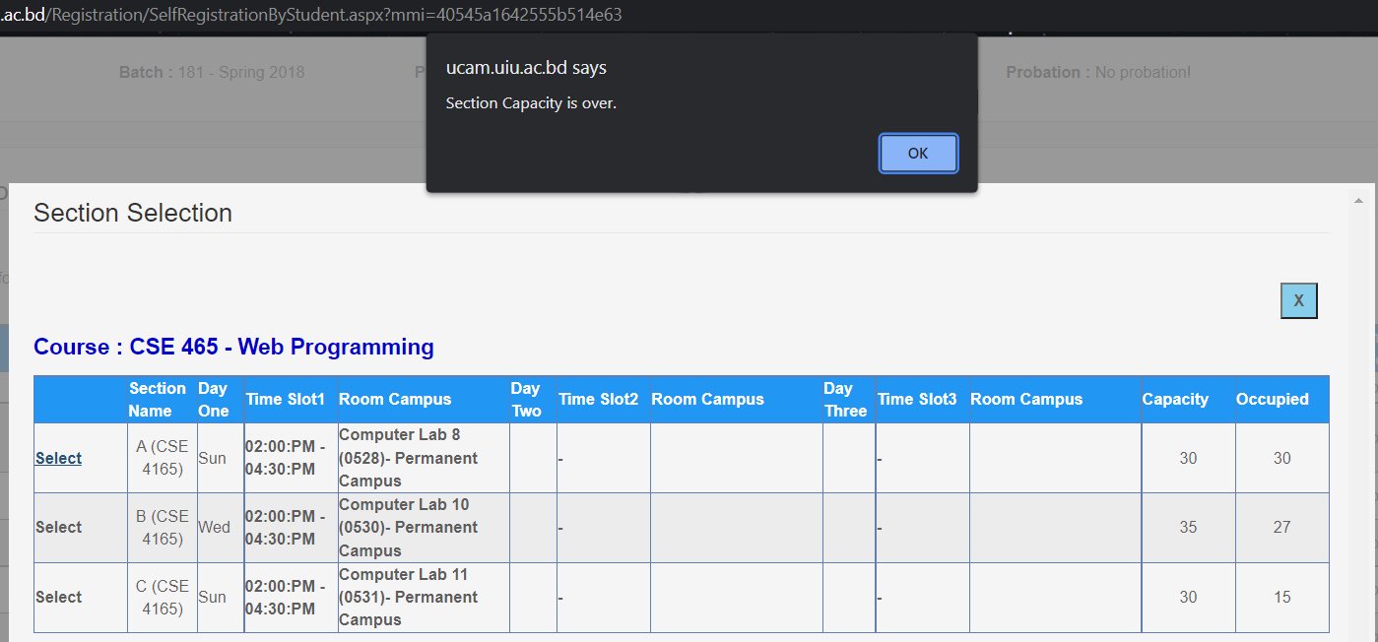
Courses Conflict with each other
CSE 465 conflicts with CSI 416

Slide 8
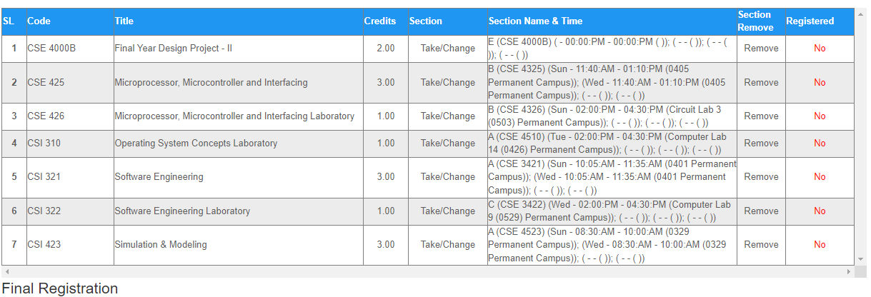
Examples of Deficient Class Routine
No Time preference

Slide 9
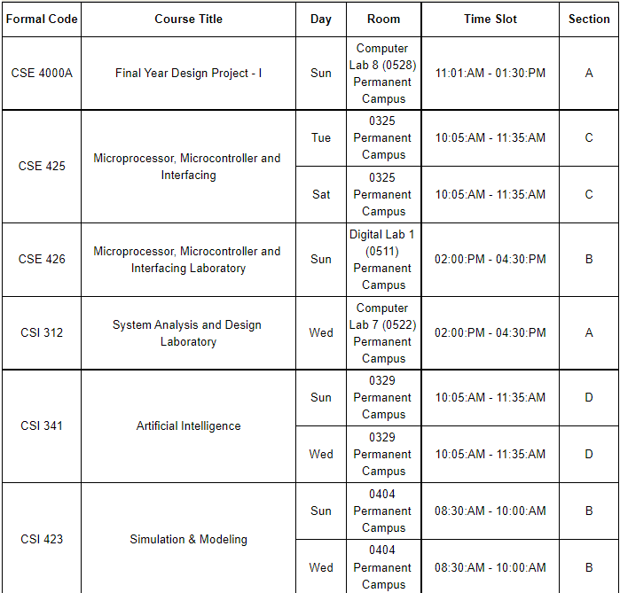
No gap between classes
Time gap between classes is too high

Slide 10
Motivation
Manual Advising Process is not very convenient & Student face difficulties while preparing routine. The generated routine is not even optimal.
Our system will provide an optimal class routine considering student time preference and will try to resolve all the hard constraints.

Slide 11
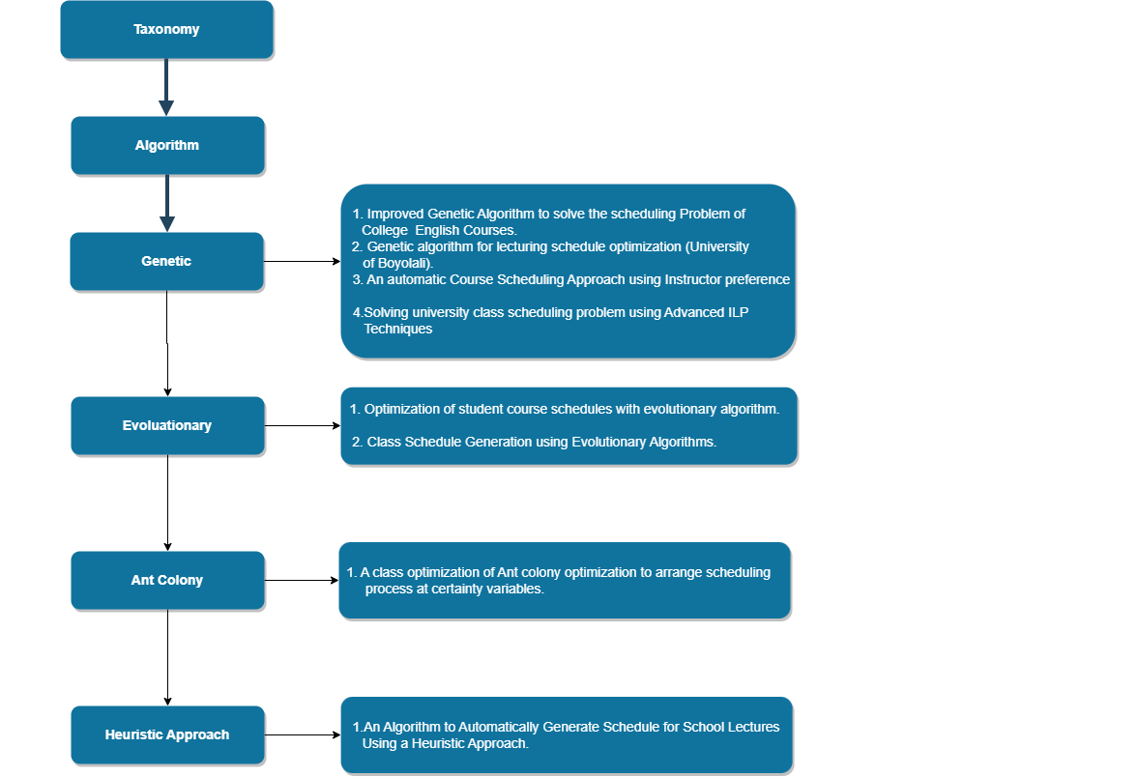
Literature Review(Taxonomy)

Slide 12
Gap Analysis
Paper Title | Published Year | Gap Analysis
An Automatic Course Scheduling Approach Using Instructors Preferences | 2012 | 1. Solved problem from Teachers Point of View 2. System generates less section 3. Only resolves conflicts, did not consider other parameters like reducing time gap,equal distribution of classes
Algorithm to Automatically Generate Schedule for School Lectures Using a Heuristic Approach | 2012 | 1.Does not have sufficient data or information 2. Solved problem from Teachers Point of View
Optimization of student personal course schedules with Evolutionary Algorithms | 2011 | 1. Only focused on generating conflicting free lecture schedules, but they did not consider any other parameters

Slide 13
Reference
[1] An Automatic Course Scheduling Approach Using Instructors Preferences
[2] An Algorithm to Automatically Generate Schedule for School Lectures Using a Heuristic Approach
[3] Optimization of student personal course schedules with Evolutionary Algorithms

Slide 14
Objectives
The primary objectives of our project are:
To develop an automated class schedule method based on students time preference.
To make sure our system is efficient and it takes less time to execute.
To design an automated class scheduling system and test its functionality in terms of accuracy, data handling, stability and adaptability in making class schedules.

Slide 15
Requirements Analysis

Slide 16
Requirements
Functional
Non-Functional
Generating class routine
Time preference based routine
Performance
Storage
Reliability

Slide 17
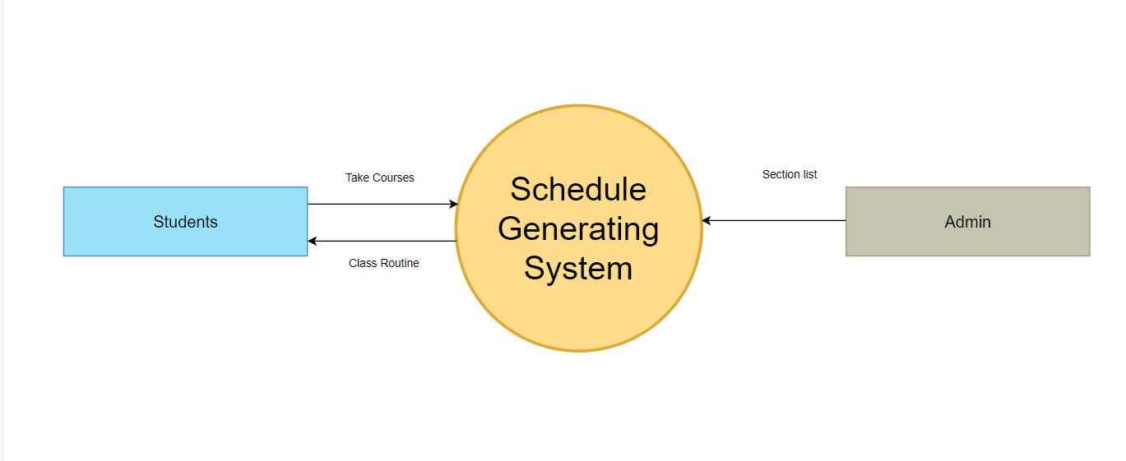
Context Diagram

Slide 18
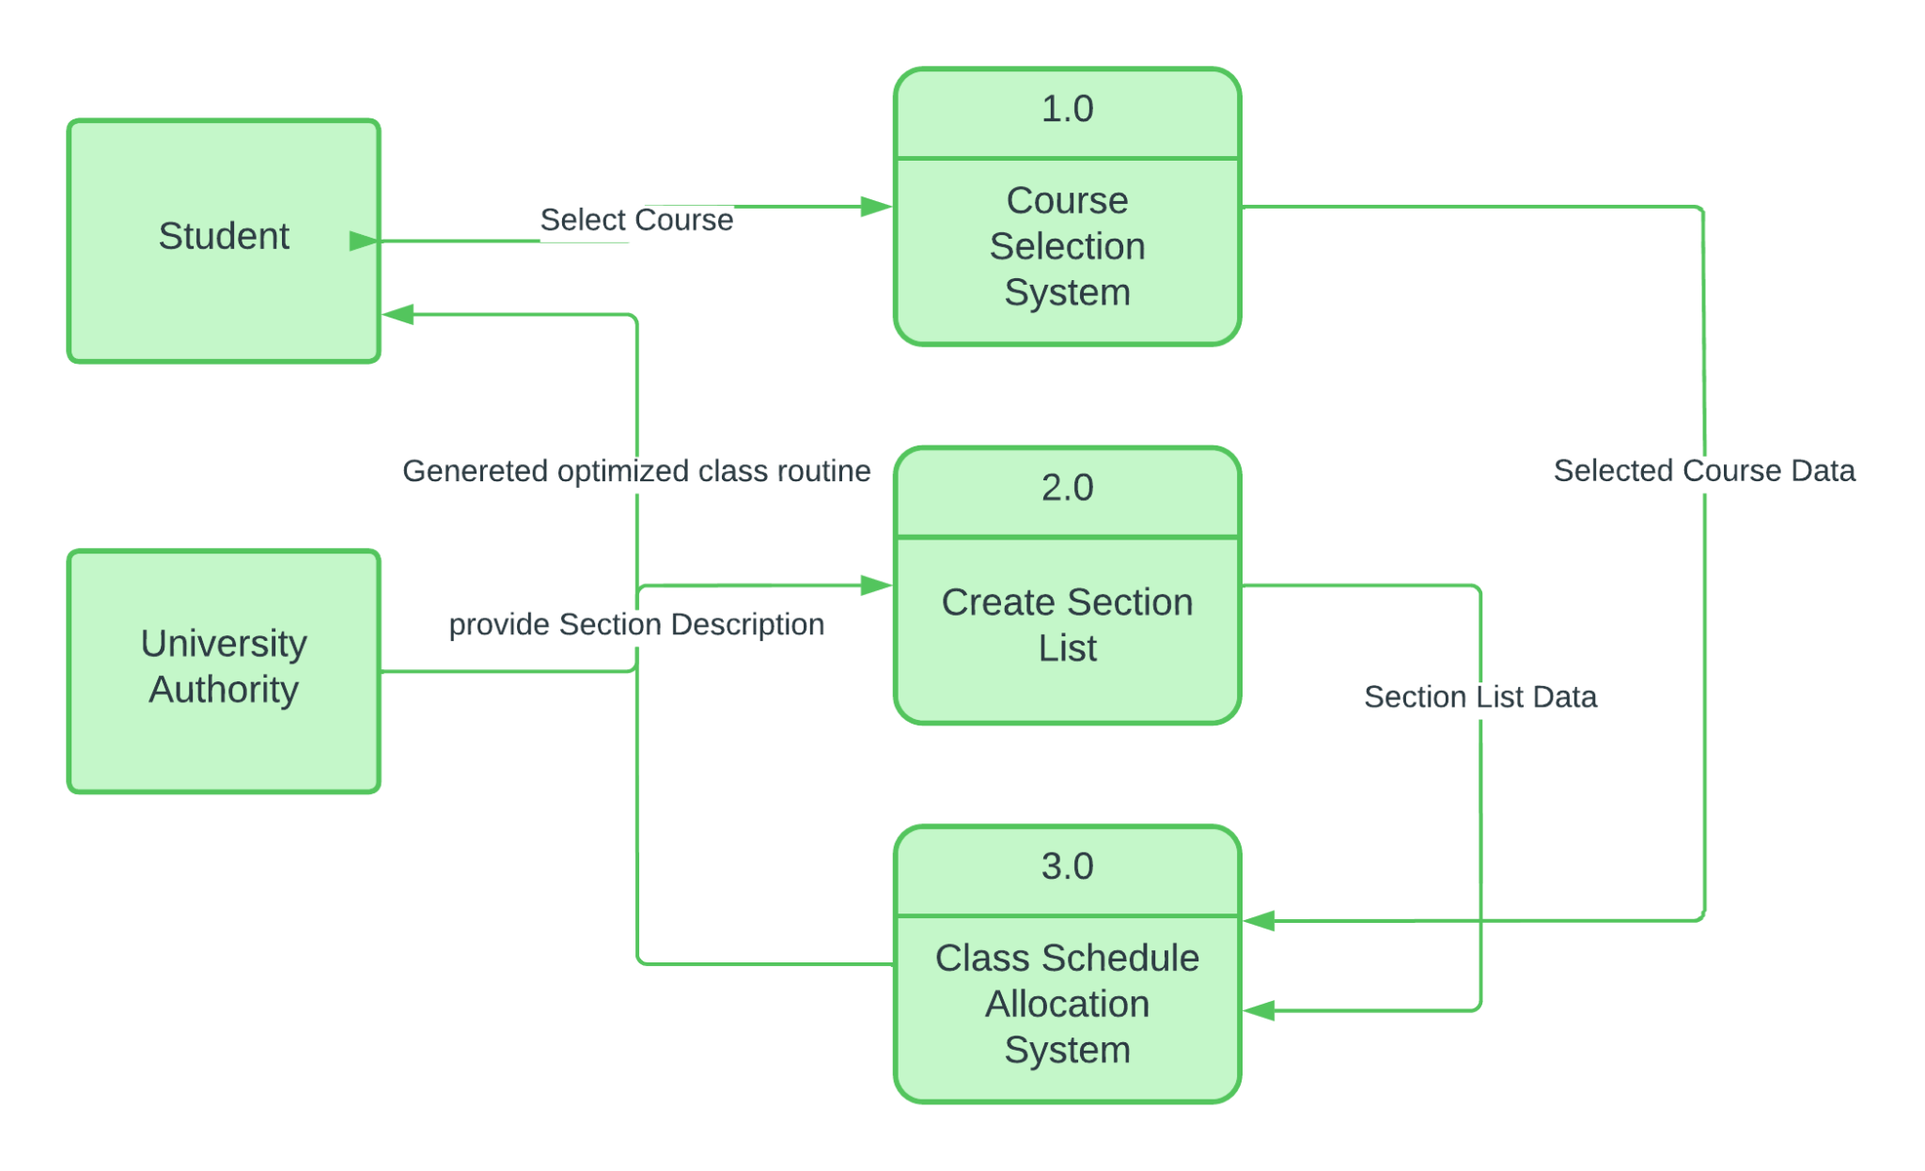
Data Flow Diagram

Slide 19
Requirements Specification
Software Requirement Specification :
Python 3.10
PyCharm 2021.3.1
Google Colaboratory
Google Drive
Microsoft Excel
Hardware Requirement Specification :
Intel Core i3 or AMD Ryzen 3 or more powerful processor
4GB or more RAM

Slide 20
Implementation

Slide 21
Input and Output

Slide 22
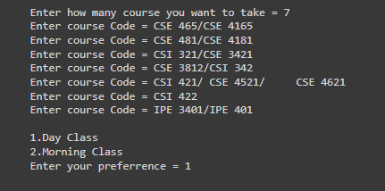
User Provided Input

Slide 23
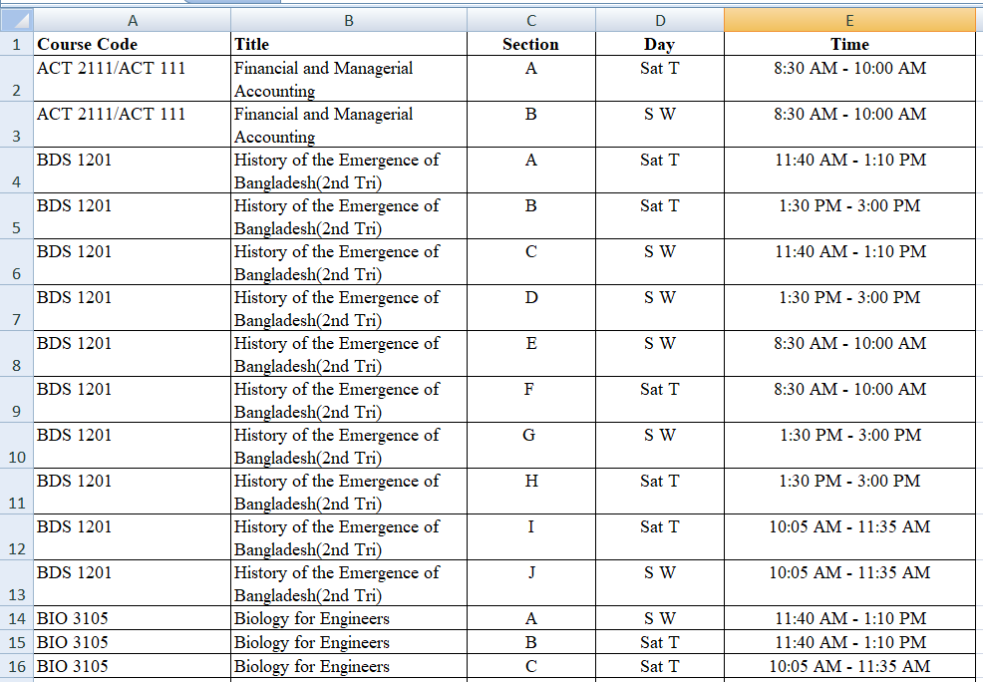
University Provided Section Information

Slide 24
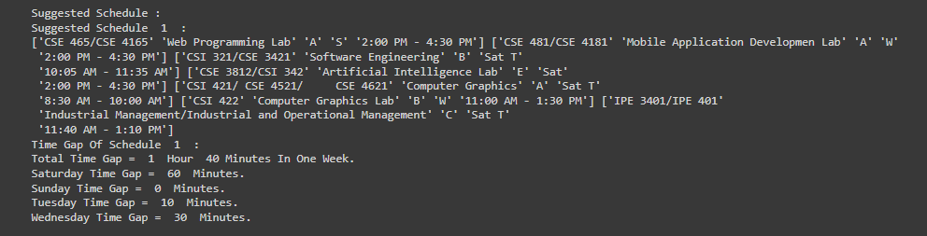
Output Suggested Schedule

Slide 25
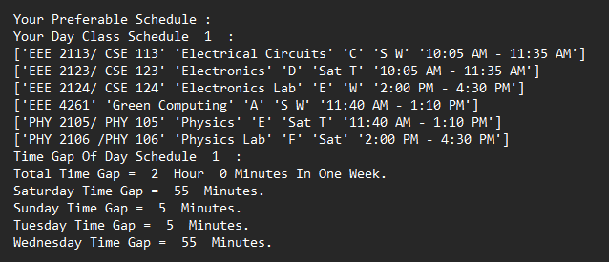
Output Preferred Schedule

Slide 26
Algorithm
Similar Component

Slide 27
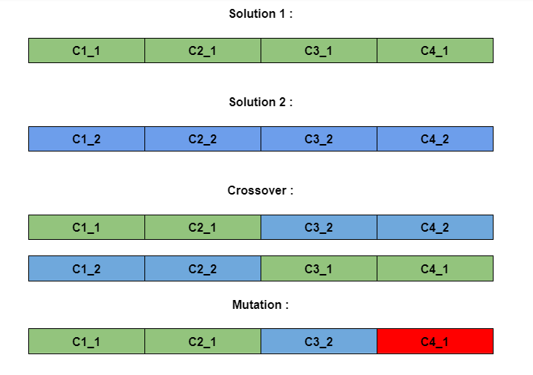
Algorithm
Genetic Algorithm

Slide 28
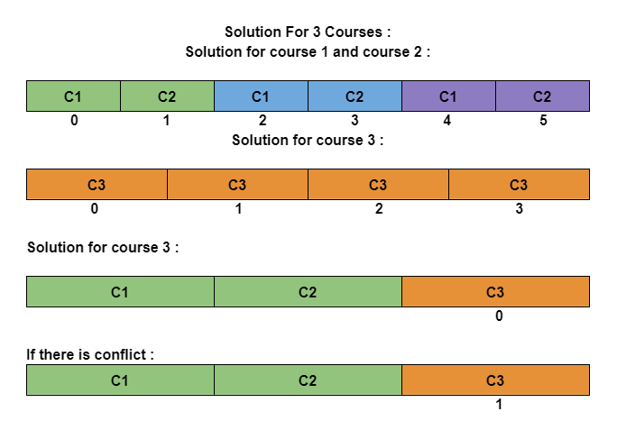
Algorithm
Our Own Algorithm

Slide 29
Flow Chart

Slide 30
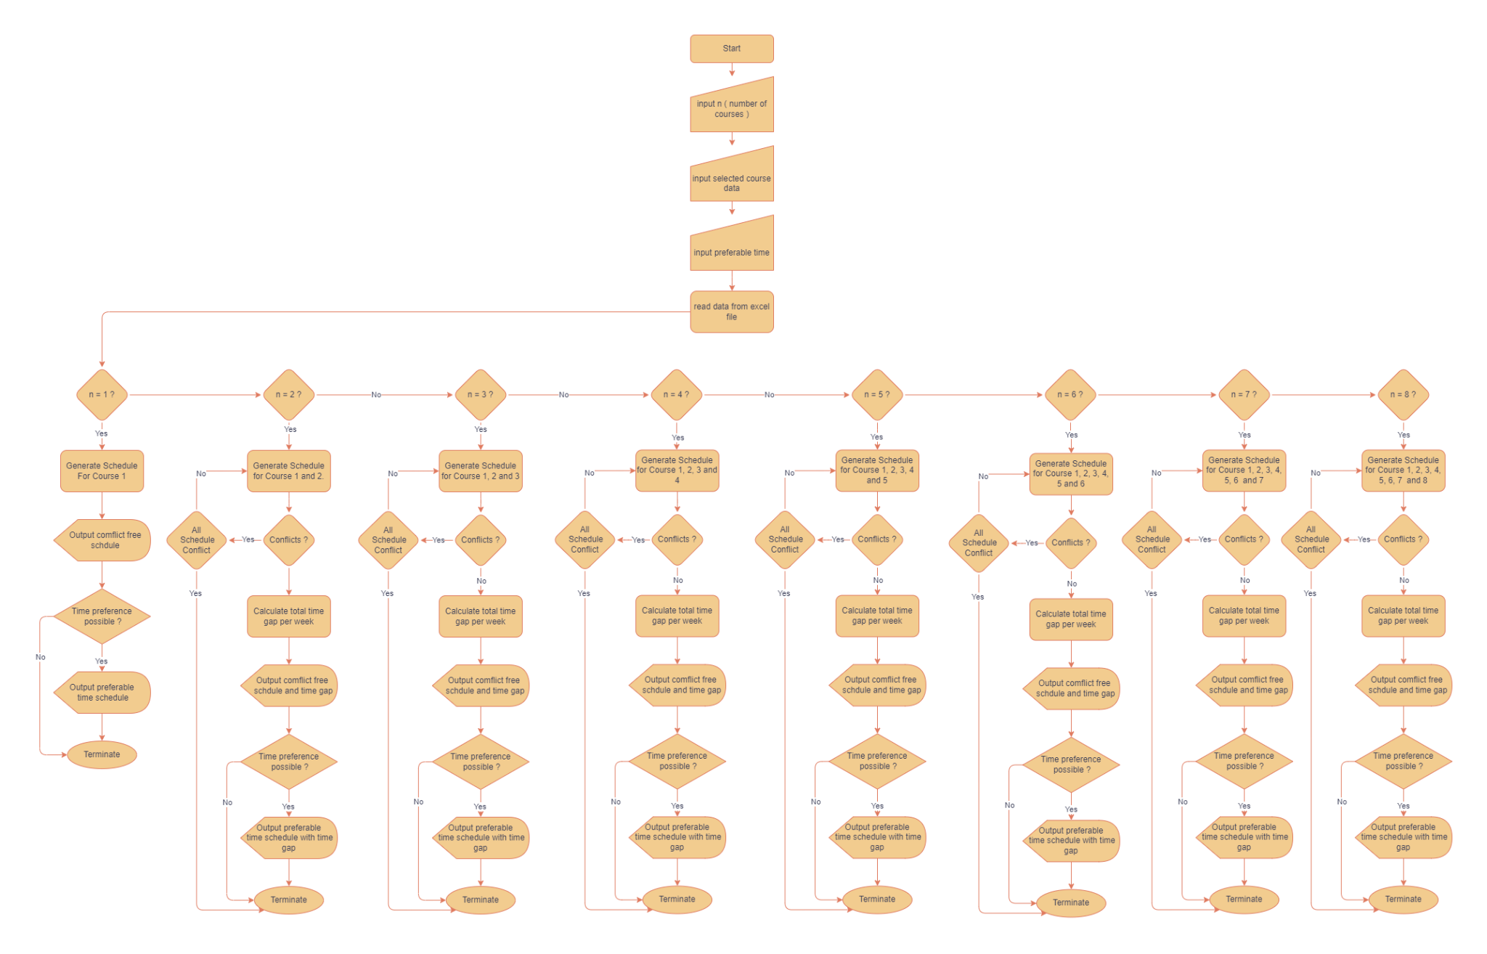

Slide 31
Algorithm For 2 Courses
For i in range(0,len(c1)) :
For j in range(0,len(c2):
If c1 and c2 both theory :
If no day and time conflict :
Result
Elif c1 and c2 both lab :
If no day and time conflict :
Result
Else : ( 1 theory 1 lab )
If c1 theory c2 lab :
If no day and time conflict :
Result
Elif c1 lab c2 theory :
If no day and time conflict :
Result

Slide 32
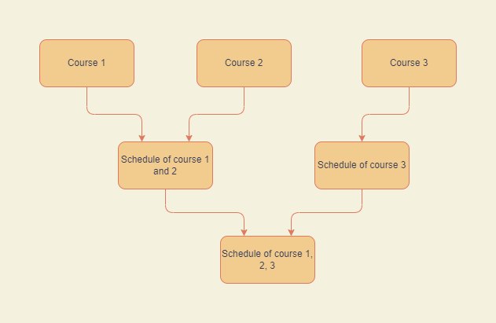
Stages Of Algorithm For 3 Courses

Slide 33
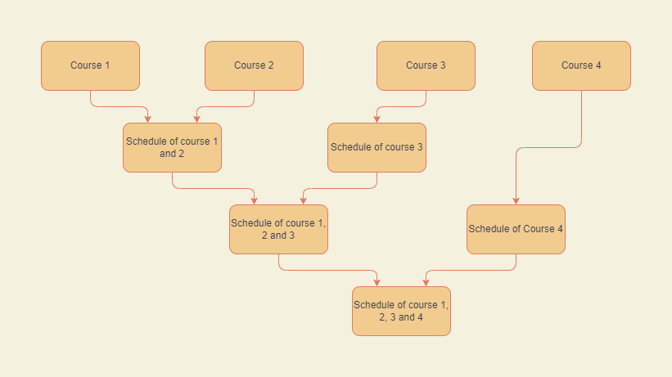
Stages Of Algorithm For 4 Courses

Slide 34
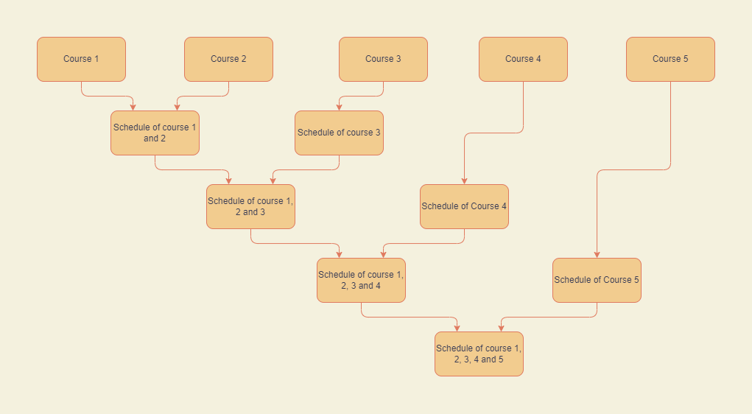
Stages Of Algorithm For 5 Courses

Slide 35
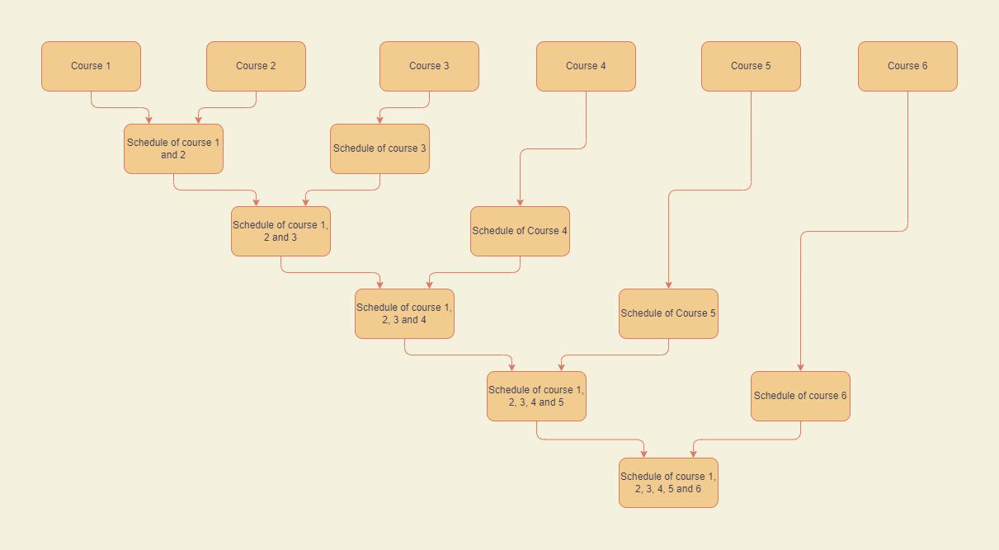
Stages Of Algorithm For 6 Courses

Slide 36
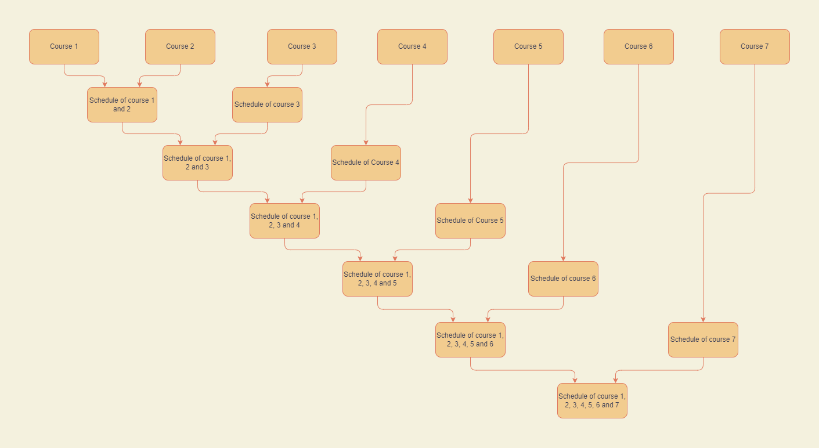
Stages Of Algorithm For 7 Courses

Slide 37
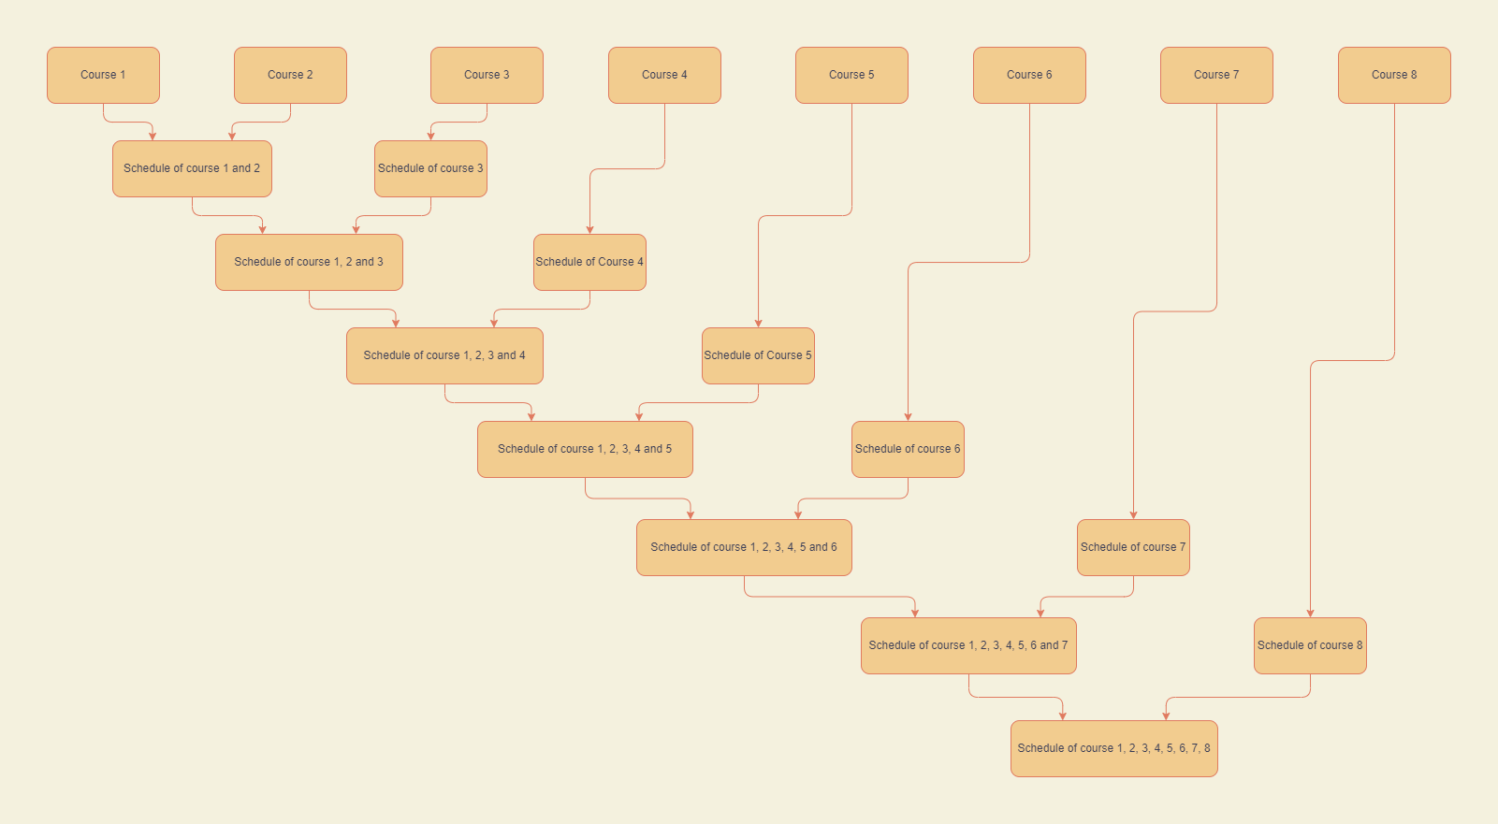
Stages Of Algorithm For 8 Courses

Slide 38
Result Analysis

Slide 39
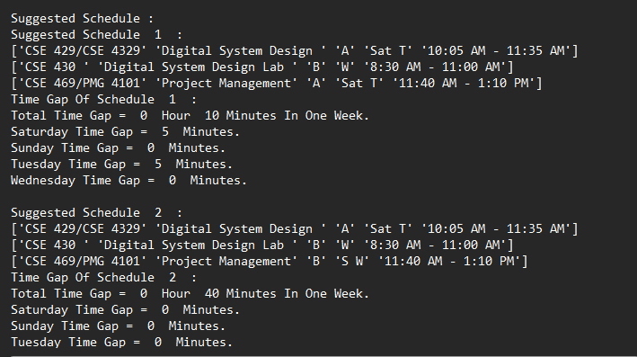
Result For 3 Courses

Slide 40
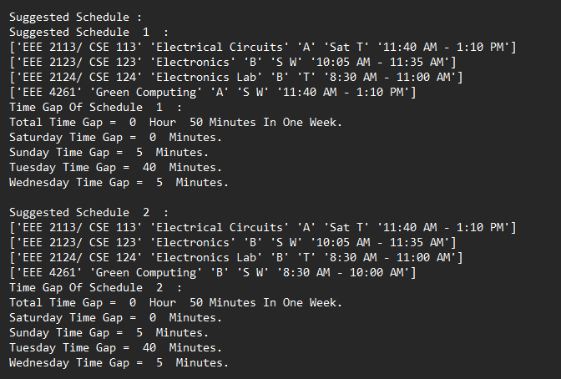
Result For 4 Courses

Slide 41
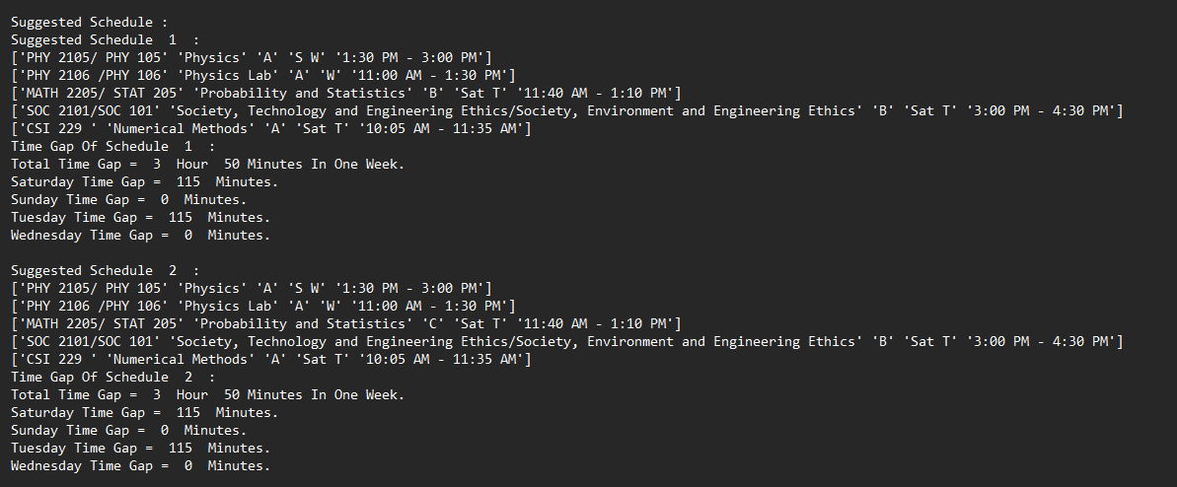
Result For 5 Courses

Slide 42
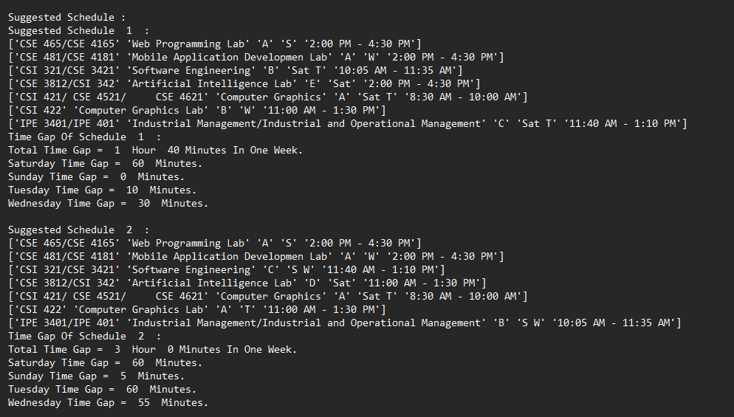
Result For 7 Courses

Slide 43
Standards
SDLC
We will use Agile Model
ISO/IEC 12207 standard
ISO/IEC
Version
Control(GIT)
IEEE
Putting everything under VCS
Performing a separate commit for every change
Labeling all releases
Coding
PEP8
Avoid Hard coding
Formatting convention
Documentation
IEEE
Ethics
7.8 IEEE
To uphold the highest standards of integrity, responsible behavior, and ethical conduct in professional activities
to avoid unlawful conduct in professional activities

Slide 44
Constraints
Economic Constraints :
Sell system to educational organizations
In the long run students will be benefited
Ethical Constraints :
Information leak and data breach
Sustainability :
Useful for next couple years
frequent update

Slide 45
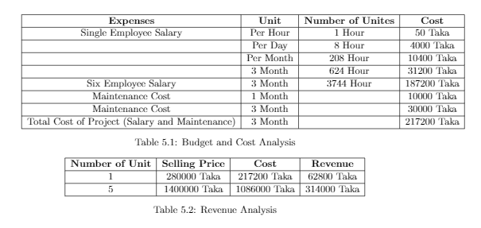
Budget and Cost Analysis

Slide 46
Task Allocation
Tanvir Hasan Emon - Algorithm Development, Implementation, Testing, Literature Review, Report Writing, Presentation Slide.
Farhana Afroz - Algorithm Development, Implementation, Testing, Literature Review, Report Writing, Presentation Slide.
Partho Protime Sarker - Testing, Data Preprocessing, Literature Review, Report Writing.
Efat Ahmed Shohel - Presentation Slide, Literature Review, Report Writing.
Joyosree Acharjee Tithi - Literature Review ,Report Writing, Presentation Slide.
Tahmina Tanjin Sharna - Literature Review ,Report Writing, Presentation Slide.

Slide 47
Future Work
Integrate with Ucam
Web based User Interface

Slide 48


